Slide 1

Solar Generation Prediction for High Growth Areas
W205 Project Progress Report
Amanda Ayles, Vincent Chu, Elizabeth Shulok
Notes:
Vincent

Slide 2

Project Objective / Scope
Research Question:
How to help utilities focus grid modernization efforts on high growth areas for solar PV and accurately size the impact from reverse power flows?
Tools to build:
Solar Growth Predictive Model:
Predictive model to identify high growth geographic areas for solar adoption based on amount of solar irradiance, average consumption and household income.
Solar Generation Estimation Tool:
Actual solar generation (KW) estimation tool based on solar panel capacity and amount of irradiance.
Notes:
Amanda
Think about what question or problem are you trying to solve?
Why is this hard or interesting?

Slide 3
Progress So Far?
Identified and finalized data sources
Created data lake setup and load bash script
Downloads data files
Creates directory structure for data files
Created data load scripts in Spark SQL
Created data transformation scripts in Spark SQL
Created investigation query scripts
Notes:
Liz

Slide 4
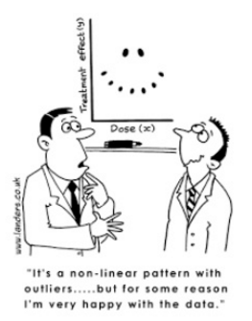



Steps to Finish Line
Serving Layer
SQL/Python Scripting
Front-end interface providing visualizations and/or interactions (if time permits)
EXTENDED FEATURES:
Add machine learning to the Solar Growth predictor
Include potential predictors for the algorithm: political affiliation, temperature, etc.
Apply a regression model to the Estimation Tool
Notes:
Vincent
The following lists the remaining work planned for the rest of our project:
Development of serving layer
Set of Python scripts for front-end users to get answers on
Solar Growth Predictive Model: Ranking of counties by growth potential of solar installations
Solar Generation Estimation Tool: Amount of solar generation based on solar installation size and amount of irradiance by month
Visualization layer of results from the above scripts
Development of extended feature (if time permits)
Solar Growth Predictive Model:
Use of Machine Learning (sklearn package)
Additional predictors such as political affiliation, temperature, etc.
Solar Generation Estimation Tool:
Regression model to estimate local shading effects based on historical solar generation data for counties with the highest projected growth

